Slide 1






Tips, tricks, and FAQs for getting started in longitudinal data analysis.
Keith Lohse, PhD
Department of Health, Kinesiology, & Recreation
Department of Physical Therapy and Athletic Training
University of Utah
rehabinformatics@gmail.com
Allan J. Kozlowski, PhD
Director of Outcomes Research, Mary Free Bed Rehabilitation Hospital
Department of Epidemiology and Biostatistics, Michigan State University College of Human Medicine
allan.kozlowski@maryfreebed.com

Slide 2
1. Know your types of variables.
Static/ “Fixed” variables are variables that keep the same value over the course of the study.
For most longitudinal studies, these are variable that vary between people but stay constant within a person (e.g., gender and age at start of study are example static variables).
Can be continuous or categorical.
Dynamic/ “Time Varying” variables are variables that change value over the course of the study.
Our principle dynamic independent variable is Time (but this could be seconds, months, or years, depending on the resolution over your data).
Most of our dependent variables are also dynamic (i.e., we might have BBS, WMFT, or 10m WT scores at each time point).
Can be continuous or categorical.

Slide 3
2. How will you model time?
Do most people tend to change linearly or non-linearly?
Is there a between-subjects variable associated with different change curves?
Exploratory data visualization I really helpful here and can inform subsequent model building.
Remember that the more complicated your hypotheses about time, the more time-points you will need to collect.

Slide 4
3. What does zero mean in your model?
Continuous Variables
Do you have an interpretable zero in your independent variables:
Age versus Onset days (Age = 0 doesn’t make sense; Onset = 0 might).
Have you mean-centered the variables in your model?
If all variables are mean-centered, you can interpret the effects of one variable “on average” across the other variables.
Is there a separate value you want to center your variables on?
I.e., look at group differences at the end rather than beginning by making the terminal point the intercept.
Categorical variables:
Contrast coded versus dummy coded variables.
Contrast codes make zero the average, dummy codes make the reference group zero.

Slide 5
4. Levels of measurement
Do you really have an interval level variable?
The errors that result from treating non-interval data as interval data actually get worse across time (e.g. FIM scores).
Especially anytime you break a scale into subscales!
Unequal differences in scale warp the shape of the time function.
Look into Rasch Scaling as an approach to “intervalizing” ordinal data.
Pragmatically, check your residuals and the assumptions of the MLM.

Slide 6
5. What effects are you interested in?
Main Effect of Time
Time by Gender Interaction
Time by Age Interaction
Person Level
Gender
Age
Time Level
Linear Effect
of Time
Often, we are interested in interactions between the person-level and the time-level, but we can also test main-effects and interactions within the person-level or within the time-level!

Slide 7
6. How do I compare between models?
Models can have different methods of estimation in order to fit their parameters:
ML – maximum likelihood estimation.
REML – restricted maximum likelihood estimation.
Often we prefer ML to REML because it allows us to compare nested models using likelihood based methods like the change in deviance or the Akaike Information Criterion (AIC).
Deviance is a measure of the amount of error in a model, so lower deviance means a better model.
This can be tested statistically with the Wald Test of the change in deviance.
AIC is also a measure of error in a model, so lower AIC means a better model.
However, the AIC also introduces a penalty for the number of parameters in a model. This makes the AIC more conservative and helps prevent “over-fitting” of the model.

Slide 8
7. How do I statistically power a longitudinal study?
Statistical power for multi-level models gets pretty complicated, so it is highly recommended that you talk to a statistical consultant. In preparation for that meeting, you’ll want to be able to phrase your main narrative hypothesis as a statistical hypothesis like the following:
“I am interested in the main-effect of time.”
You will need to estimate how much you expect participants to change over time, estimate the average standard deviation at each time point, and the average correlation between time points.
“I am interested in the interaction of time and group.”
You will need to estimate all of the same information as above, but you will need to estimate it for each group.
As a rule of thumb, increasing the number of time-points will improve power for effects at the time-level and person by time interactions.
Increasing the number of participants will improve power for effects at the person-level and person by time interactions.

Slide 9
8. What if I have multiple levels?
Multi-level models can do that!
Let’s say that you are running large international study…
Or combining data from lot’s of different studies in secondary analysis…
Country Level
London
Paris
Atlanta
Clinic Level
C1
C2
C3
C4
…
…
Person Level
P1
P2
P3
P4
…
…
Time Level
T1
T2
T3
T4

Slide 10
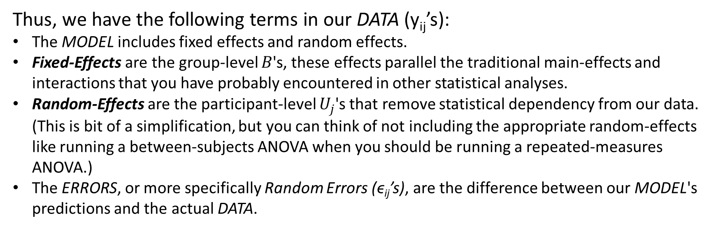
9. What are Fixed-Effects and Random-Effects?
Remember the general concept of DATA = MODEL + Error.
This can be more elaborately written as:
$$y_{ij}=B_{0}+U_{0j}+(B_{1}+U_{1j})∗(TIME_{ij})+ε_{ij}$$
Thus, we have the following terms in our DATA (y_{ij}’s):
The MODEL includes fixed effects and random effects.
Fixed-Effects are the group-level $B$'s, these effects parallel the traditional main-effects and interactions that you have probably encountered in other statistical analyses.
Random-Effects are the participant-level $U_{j}$'s that remove statistical dependency from our data. (This is bit of a simplification, but you can think of not including the appropriate random-effects like running a between-subjects ANOVA when you should be running a repeated-measures ANOVA.)
The ERRORS, or more specifically Random Errors (ϵ_{ij}’s), are the difference between our MODEL's predictions and the actual DATA.

Slide 11
10. Assumptions
Normality
Does transforming the DV change the model?
Make it clear to readers that you tested transformed and raw DVs.
Homoscedasticity
Scale Invariance
Is there bias in the models predictions?
Explore methods for looking at measurement variance over time.
Influential data points/sources
There are tools for checking Cook’s Distances and VIFs in MLMs.
Influential data don’t always show up in univariate plots/analyses.
See philosophical discussions about outliers and removing influential data points.
Run the model both ways and be transparent about what you did in your write-up.
Floor/Ceiling Effects

Slide 12
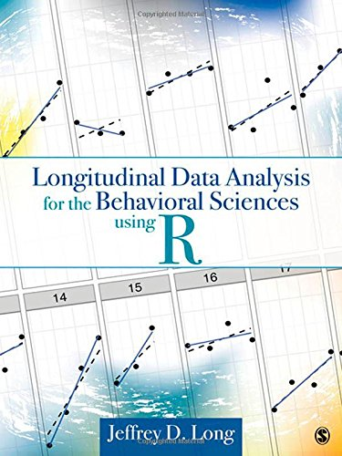

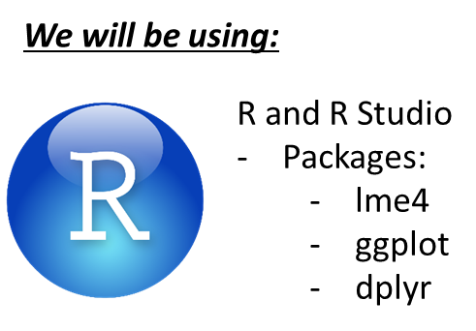



11. How can I actually run my multi-level models?
There are numerous texts to help and software packages to do it. They are all slightly different, but users need the same basic understanding of fixed-effects and random-effects to make sure models run correctly.
But you can also use:
Most of what I will say has been said better in these resources!

Slide 13
12. Be up front about your limitations.
Exploratory modelling.
You will test a lot of things you probably didn’t plan on testing, but be transparent in the reporting of your analyses.
The dataset that generates a model/prediction cannot also be used to confirm that model/prediction.
Are your results “robust” to the method of analysis?
A lot of issues about how you are modelling times, do you meet normality, or should exclude an influential data point can be addressed by running the model both ways.
Is the answer the same both time? Is a difference in the answer meaningful?

